Slide 1

Chip
Chip
Adiabatic Boundaries
Adiabatic Boundaries
v_{i}
v_{c}
Tool
Panel P_{i}
q_{shear}
q_{frict}
v_{c}
Tool
Panel P_{j}
q_{friction}
Work piece
q_{rubb}
Work piece
q_{shear}
q_{rubb}
$\left(\begin{matrix}\begin{aligned}A_{11} \\ ⋮ \\ A_{kl} \\ A_{k+1,1}\end{aligned} & \begin{aligned}⋯ \\ \\ \\ \end{aligned} & \begin{aligned}A_{lj} \\ ⋮ \\ A_{kj} \\ A_{k+1j}\end{aligned} \\ ⋮ & & ⋮ \\ A_{il} & ⋯ & A_{ij}\end{matrix}\right) ∙ \left(\begin{aligned}s_{1} \\ ⋮ \\ s_{k} \\ s_{k+1} \\ ⋮ \\ s_{j}\end{aligned}\right)$= $\left(\begin{aligned}b_{1} \\ ⋮ \\ q_{k} \\ q_{k+1} \\ ⋮ \\ b_{i}\end{aligned}\right)$
Influence matrix Sources BC

Slide 2
y
v_{ij}*
u_{ij}*
Panel P_{i}
K_{i}
K_{i+1}
r_{ij}
β_{ij}
r_{ij+1}
y*
x*
s_{j}
K_{j+1}
K_{j}
Panel P_{j}
x

Slide 3



v
y
v
Chip
y
v_{ij}*
v_{ch}
Panel P_{i}
u_{ij}*
B
K_{i+1}
x
C
Tool
K_{i}
q_{shear}
q_{friction}
v_{c}
r_{ij}
A
q_{rubb}
β_{ij}
r_{ij+1}
y*
v_{c}
D
x*
s_{j}
K_{j+1}
K_{j}
Panel P_{j}
$$\overset{→}{V_{c}}$$
$$\overset{→}{V_{c}}$$
x
x*
K_{j+1}
$$\overset{→}{V_{c}}$$
K_{i+1}
u_{ij}*
r_{ij+1}
β_{ij}
s_{j}
v_{ij}**
r_{ij}
K_{i}
K_{j}
Panel P_{i}
y*
Panel P_{j}
x

Slide 4
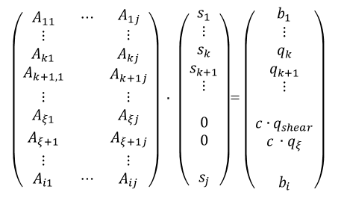
x_{contact}
v
v
Chip
v
v_{ch}
v
v
Panel ξ + η
Panel ξ + 1
Panel ξ
Tool
$\left(\begin{matrix}\begin{aligned}A_{11} \\ ⋮ \\ A_{k1} \\ A_{k+1,1}\end{aligned} & \begin{aligned}⋯ \\ \\ \\ \end{aligned} & \begin{aligned}A_{1j} \\ ⋮ \\ A_{kj} \\ A_{k+1j}\end{aligned} \\ ⋮ & & ⋮ \\ A_{ξ1} & & A_{ξj} \\ A_{ξ+1} & & A_{ξ+1j} \\ ⋮ & & ⋮ \\ A_{i1} & ⋯ & A_{ij}\end{matrix}\right) ∙ \left(\begin{aligned}s_{1} \\ ⋮ \\ s_{k} \\ s_{k+1} \\ ⋮ \\ \\ 0 \\ 0 \\ \\ s_{j}\end{aligned}\right)$= $\left(\begin{aligned}b_{1} \\ ⋮ \\ q_{k} \\ q_{k+1} \\ ⋮ \\ \\ c∙q_{shear} \\ c_{ }∙q_{ξ} \\ \\ b_{i}\end{aligned}\right)$
q_{shear, chip}
v_{c}
q_{friction}
q_{shear,wp}
q_{rubb}
Work piece
Influence matrix Sources BC
x

Slide 5
Span
Schnittrichtung
Werkzeug
Werkstück

